Slide 1

Enhancing Odor Classification in E-Nose Systems
Resia Suvejda Kiliç
Master of science in computer engineering
Supervisor: Prof. dr bekir karlik
2025

Slide 2
OVERVIEW
01 INTRODUCTION
02 MOTIVATION & PROBLEM
03 OBJECTIVE & CONTRIBUTION
04 DATASET
05 DATA PREPROCESSING
06 MODEL ARCHITECTURE
07 IMPLEMENTATION - BACKEND
07 IMPLEMENTATION - FRONTEND
08 RESULTS & COMPARISON
09 CONCLUSION & FUTURE WORK

Slide 3
01 Introduction
Odor Classification is the process of identifying gases based on sensor signals
Electronic Nose is a sensor array system mostly suited into a device that mimics the human olfactory system to detect and classify odors
Used in healthcare, food quality, environmental monitoring

Slide 4
02 Motivation & Problem
Limitations of Traditional Machine Learning Models:
Struggle with time-based changes in sensor signals
Cannot adapt to long-term sensor drift and changing patterns
Why Deep Learning is Needed:
Understands how different sensors respond together at the same time
Captures time sequences
Focuses on important contextual features within the signals
Sensor Drift
Sensor response weakens due to aging or temp.

Slide 5

03 Objective & Contribution
Propose a hybrid deep learning model combining CNN + LSTM + Transformer
Improve odor classification accuracy over time even when conditions are not ideal
Develop a desktop application for training, evaluation, and model comparison

Slide 6

04 Dataset
Gas Sensor Array Drift Dataset
13,910 samples
Collected for 36 months
6 gases (Ethanol, Ethylene, Ammonia, Acetaldehyde, Acetone, Toluene)
16 sensors (4x of each sensor) -> 128 features/sample

Slide 7
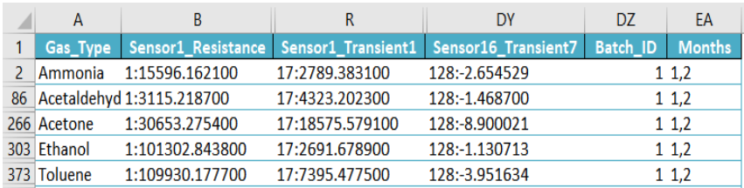
05 Data Preprocessing
Handle missing data by removing major issues and filling minor ones with estimated values
Normalization with StandardScaler by Scikit-learn
Changed shape to (Time, Sensors) to work with LSTM and Transformer models
Data augmentation to help the model learn to handle variations in real-world data
Adding small random variations of Gaussian noise
Moving the signal slightly forward or backward in time
Scaling the signal’s strength
Data grouped in batches for some time after processing

Slide 8
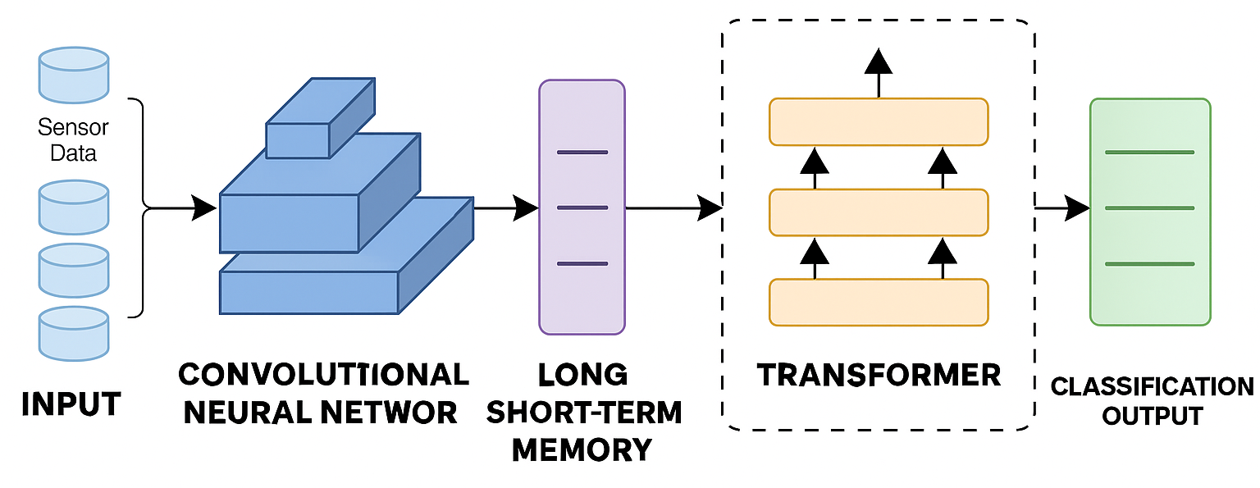
06 Model architecture
Uses attention to focus on the most important time segments
Models how these patterns change over time
Captures local signal patterns
Combined, they improve accuracy and help the model adapt to sensor noise and drift

Slide 9

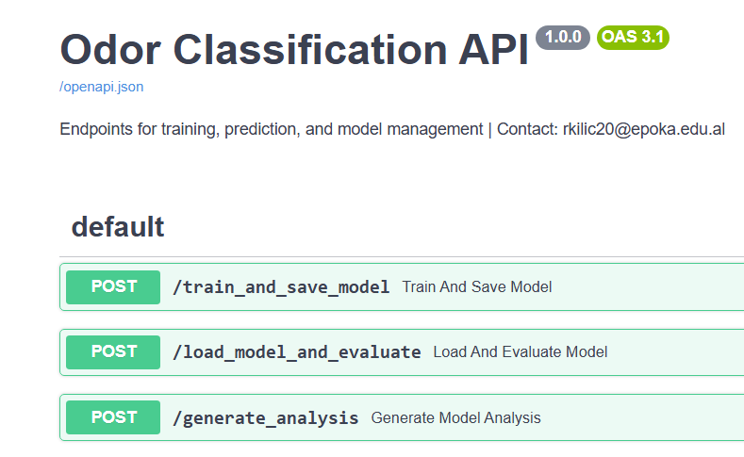


07 implementation - Backend
Client
FastAPI handles training, evaluation, visualizations
Request
API
GUI
Backend
Response
Request: Epochs, Batch Size, LR, Model Name
Response: Metrics and Visuals of the Trained Model
Request: Model File from Local
Response: Metrics and Visuals of the Evaluated Model
Request: Model File from Local
Response: Natural language analysis based on metrics of model

Slide 10
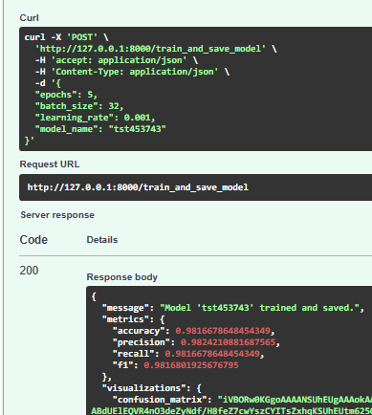
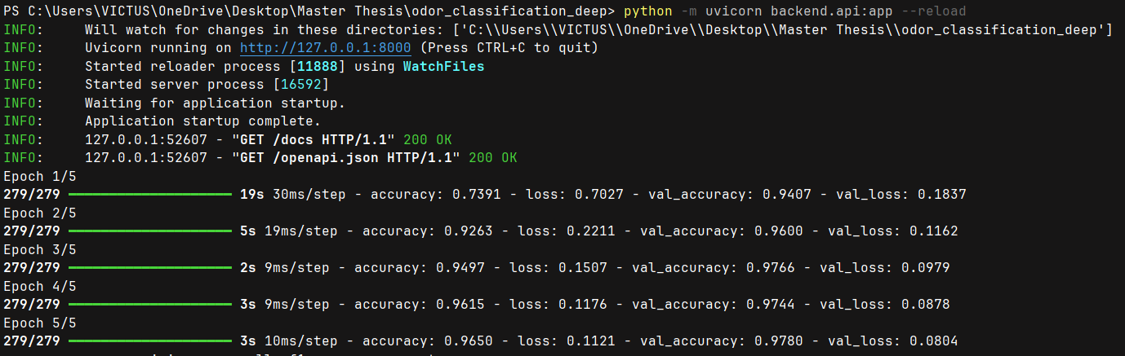
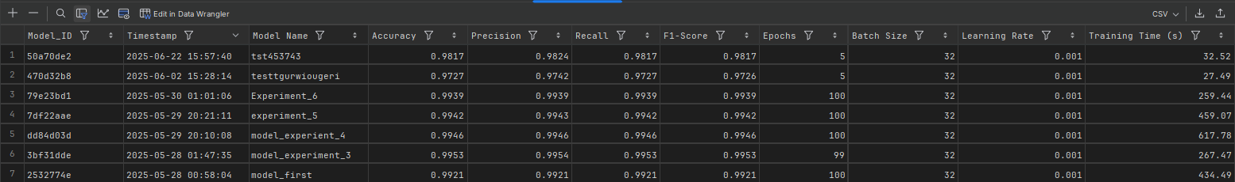

Slide 11
07 implementation - Frontend
PyQt5 GUI desktop app with:
Inputs for hyperparameters (epochs, batch size, learning rate)
User can train, evaluate and compare models
Visual results: Loss/Accuracy curves, Confusion Matrix, Feature Importance
Use Case 2: Evaluate Existing Model
Use Case 1: Train New Model
Input Epochs, Batch Size, LR, Model Name
Start Training
Get Visualizations and Metrics
Load a model from files
Start Evaluating
Get Visualizations, Metrics and Analysis

Slide 12
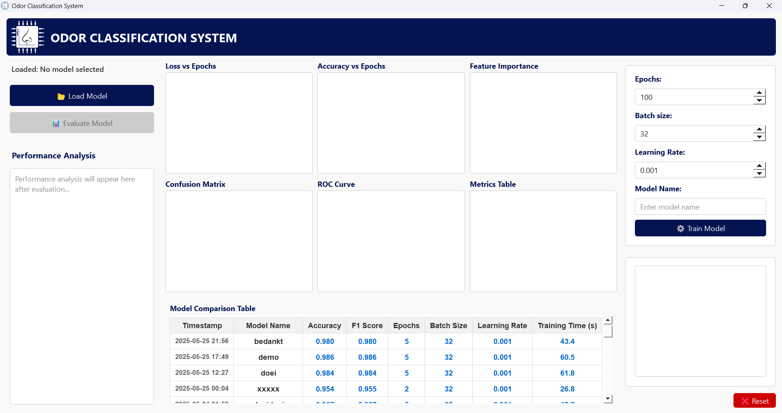
App at starting

Slide 13
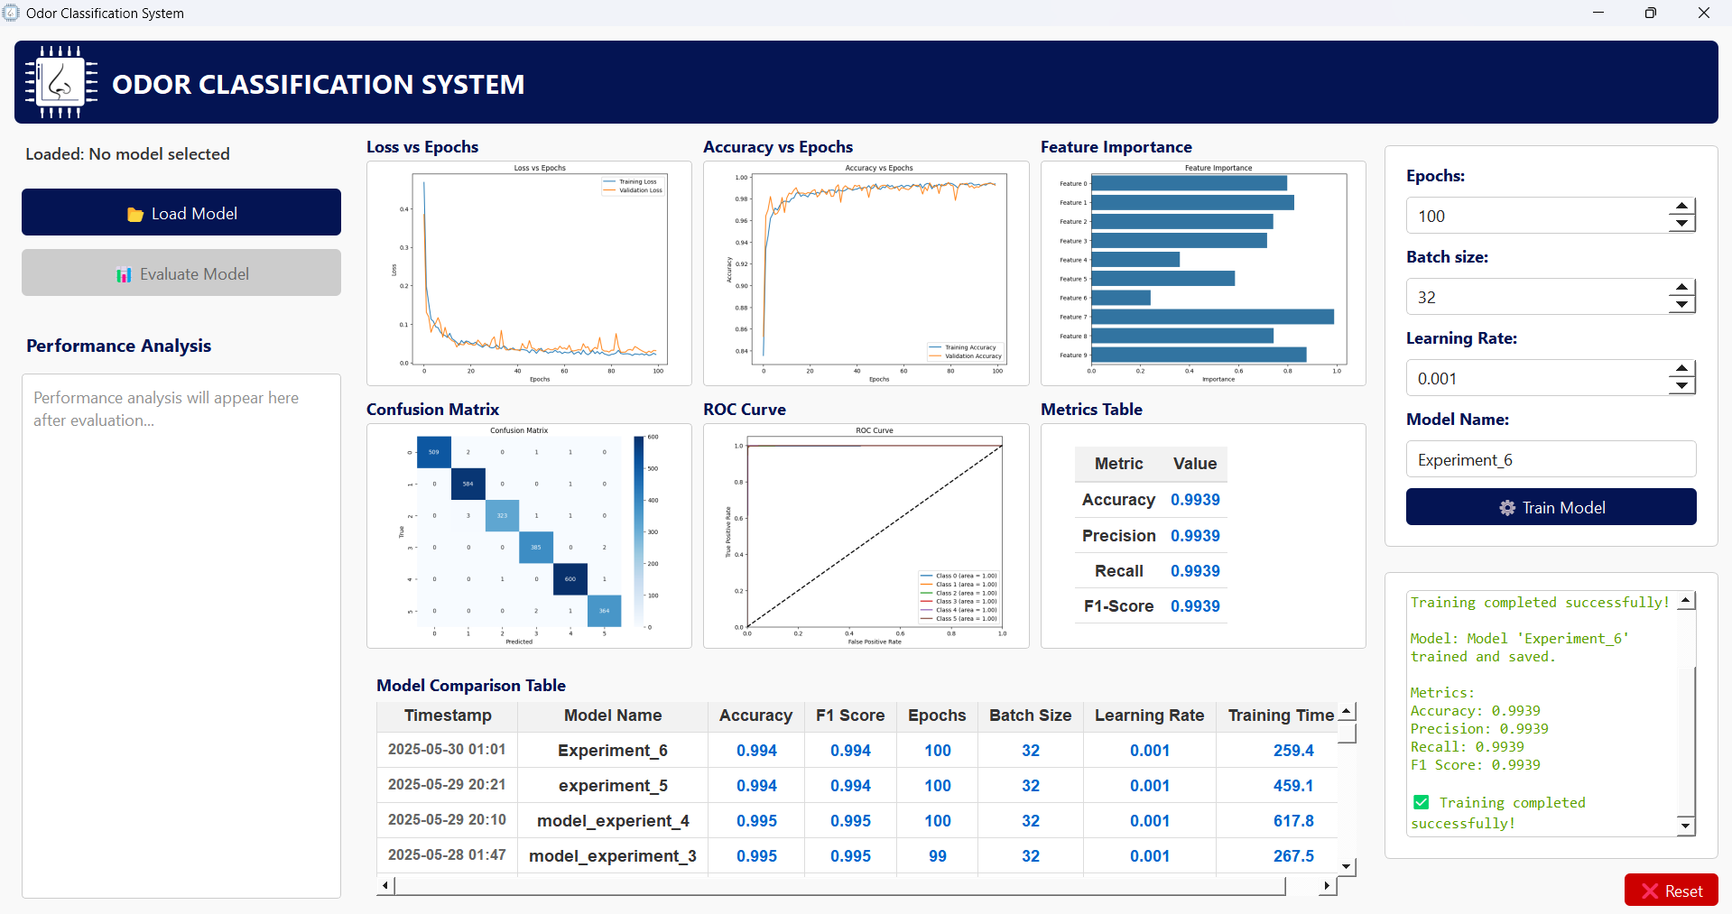
App after a model is trained (use case 1)

Slide 14
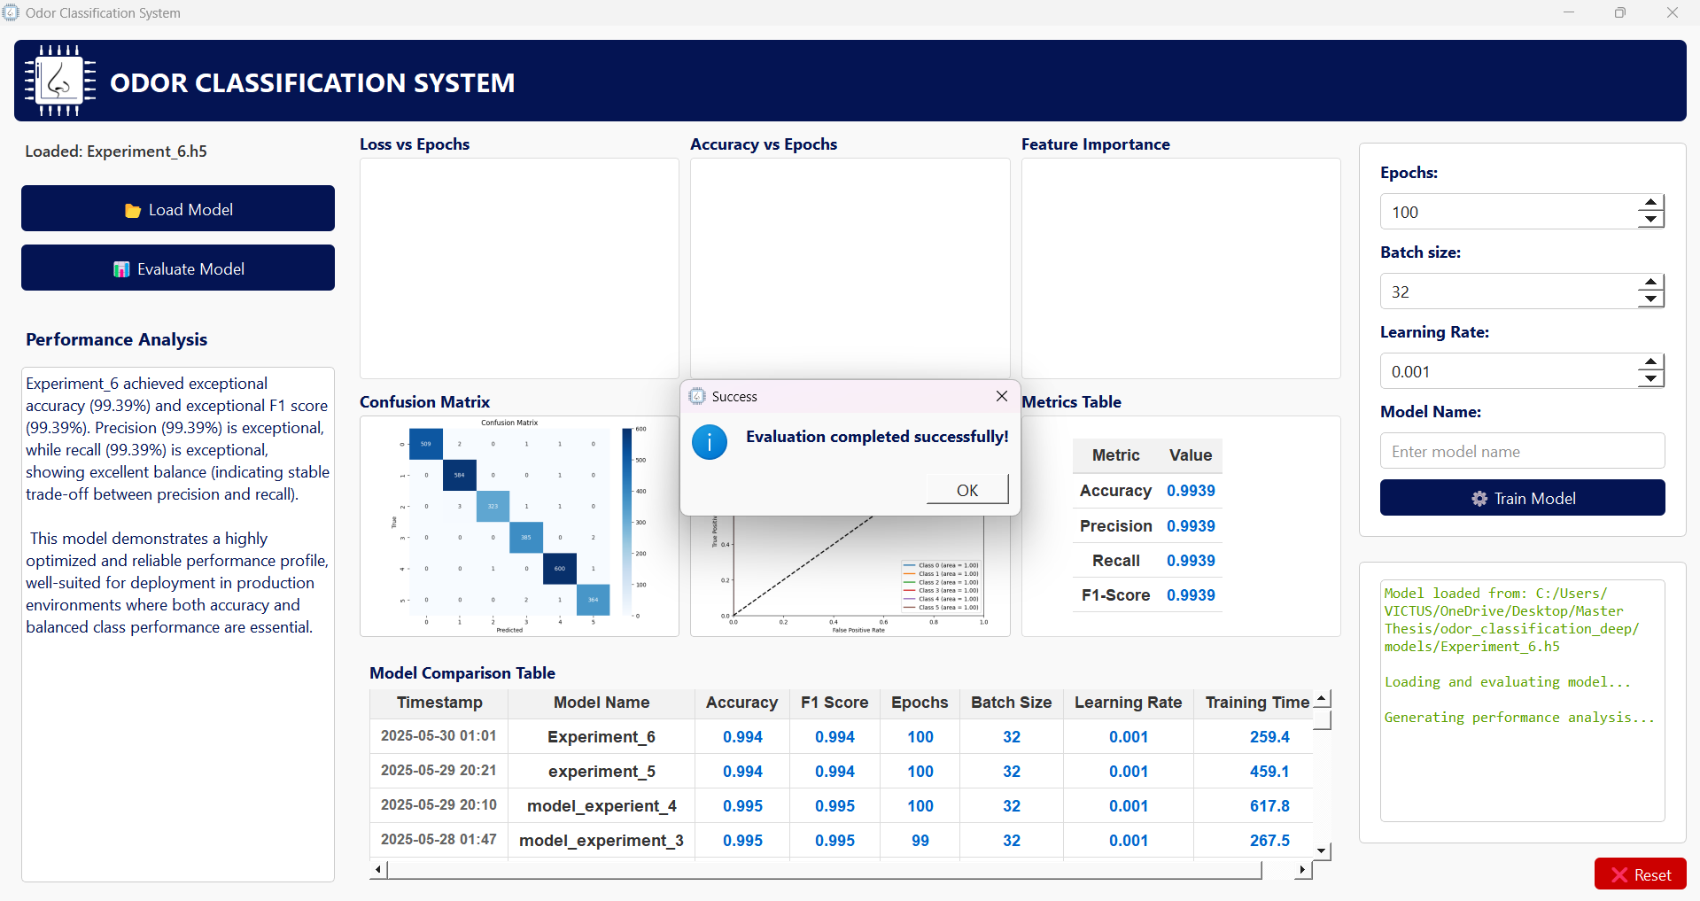
App after a model is evaluated (use case 2)

Slide 15
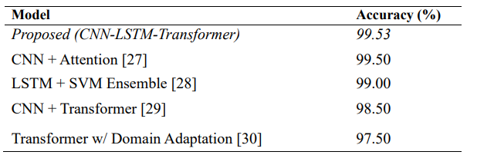
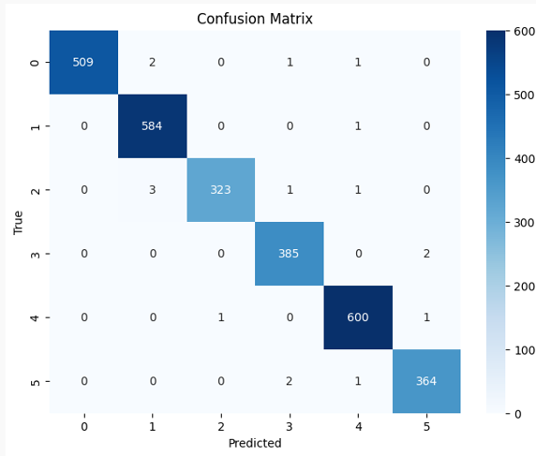
08 Results & Comparison
CNN + Attention – basic attention mechanisms | Our model uses LSTM to remember time patterns + Transformer to catch big-picture info
LSTM + SVM Ensemble - limited by basic ML methods
CNN + Transformer - weaker at extracting complex features
Transformer with Domain Adaptation - less stable
Most values are diagonally aligned which means almost
all samples were used for the prediction

Slide 16
09 Conclusion & Future Work
Conclusion
Hybrid deep learning (CNN-LSTM-Transformer) handles complex odor patterns effectively
Strong for chemical sensing tasks with noisy, time-based sensor data
Our model achieves faster training and higher performance with greater precision and flexibility, making it better than other models and suited for real-world applications and future advancements
Future Work
Improve drift correction techniques
Hyperparameter Optimization
Deploying the API and the app to Live for broader use
Adding new data uploading button in the GUI
Integration of interactive dashboards (e.g., via Dash)

Slide 17
Thank you for your attention!

